Slide 1
User Flow: DH Weekly Reporting

Slide 2
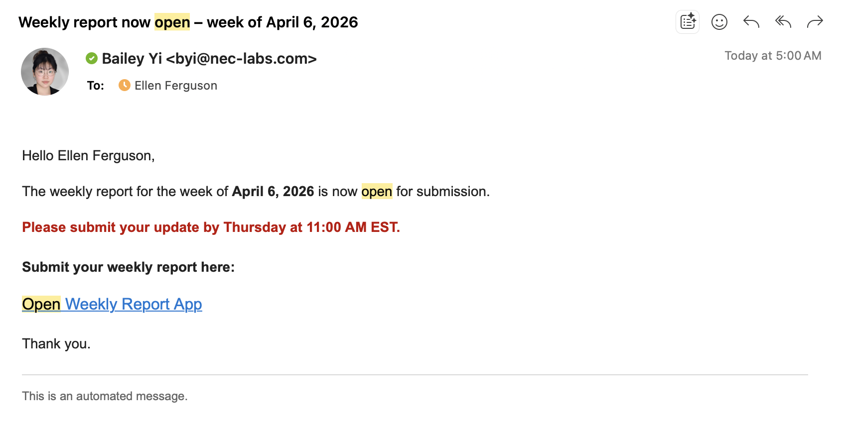
Department heads receive email each week on Monday, 5 am EST, indicating portal for the week is now open

Slide 3
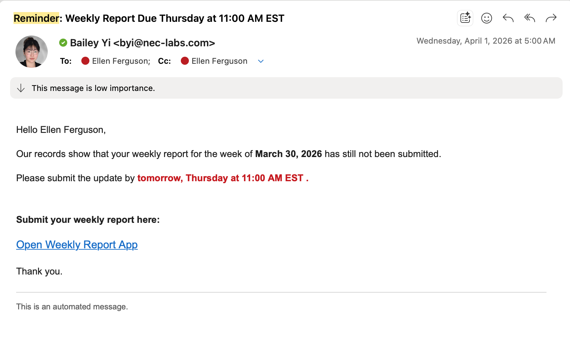
2) On Wednesday, department heads who have not submitted their weekly submission are reminded via email

Slide 4
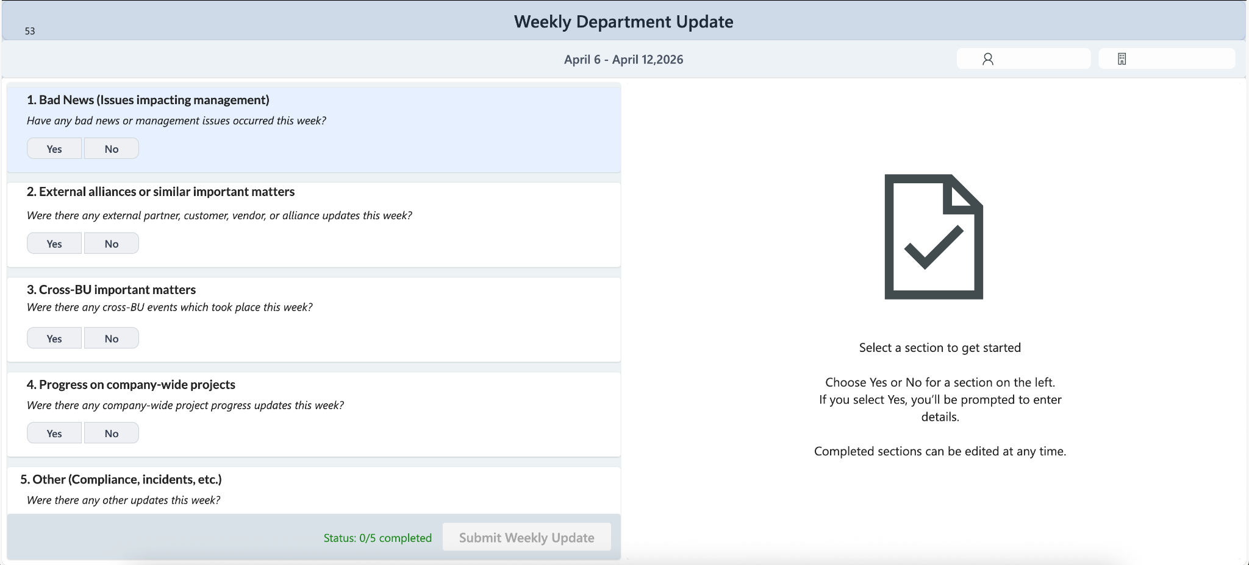
3) Clicking on the “Open Weekly Report App” brings the user to a power apps page

Slide 5
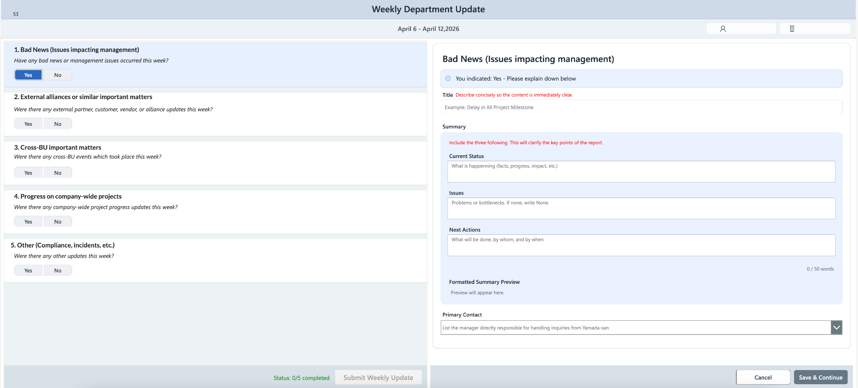
4) For sections where the Department Head selects “Yes”, they’re prompted to fill out a series of fields and to click “Save & Continue”

Slide 6
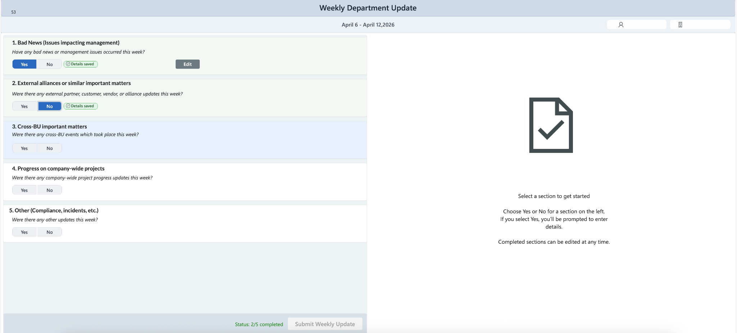
5) Department heads are able to select “No” for any section, and can still progress onto filling out the next section

Slide 7
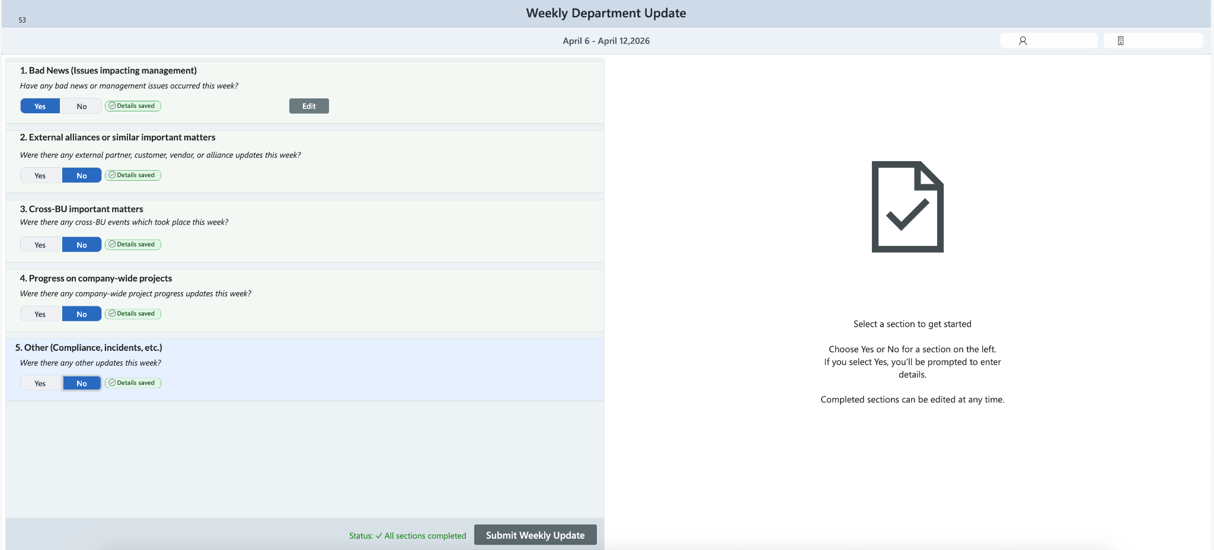
6) Once all 5 sections are complete, users can click “Submit Weekly Update”

Slide 8
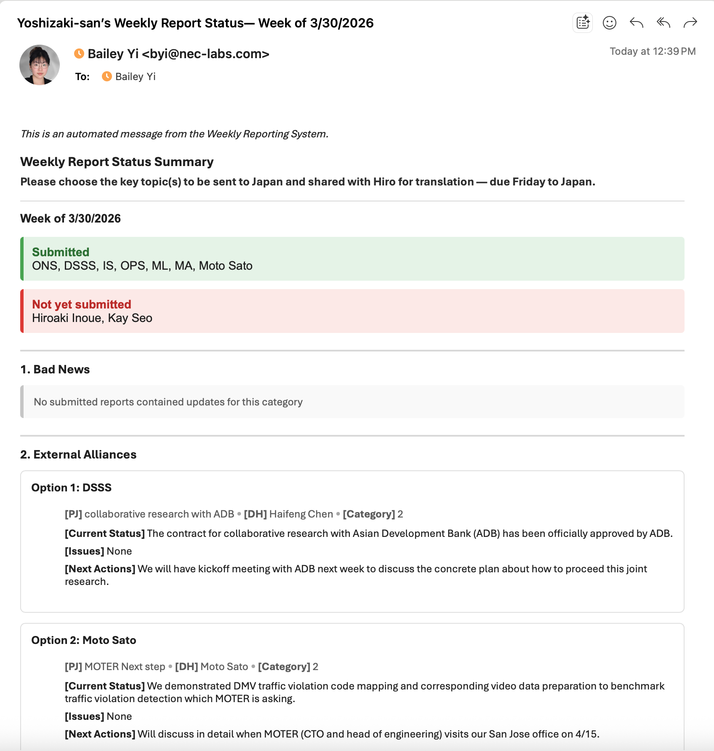
7) On Thursday at 1pm EST, all reports are automatically formatted into an email that gets sent to Chris for topic selection

Slide 9
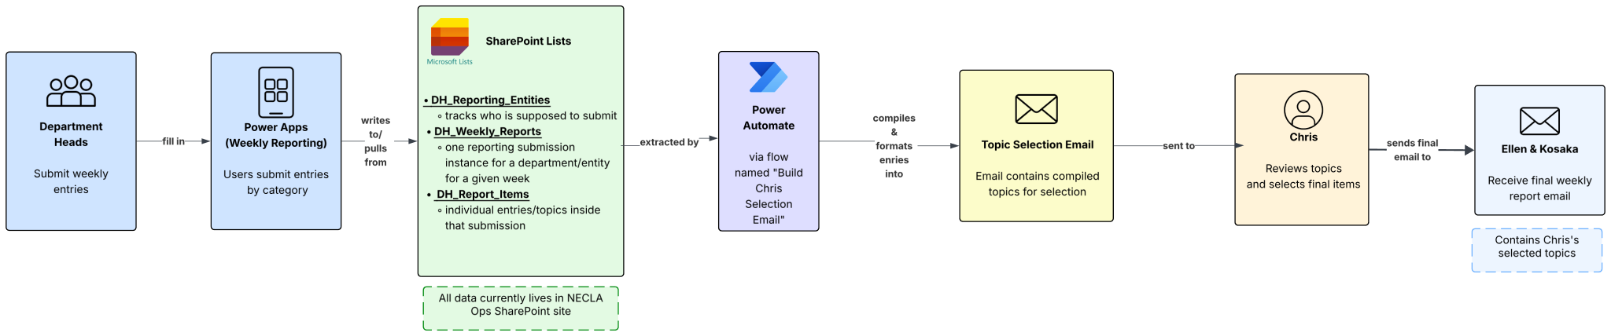
Weekly Reporting Flow Diagram (High Level)

Slide 10
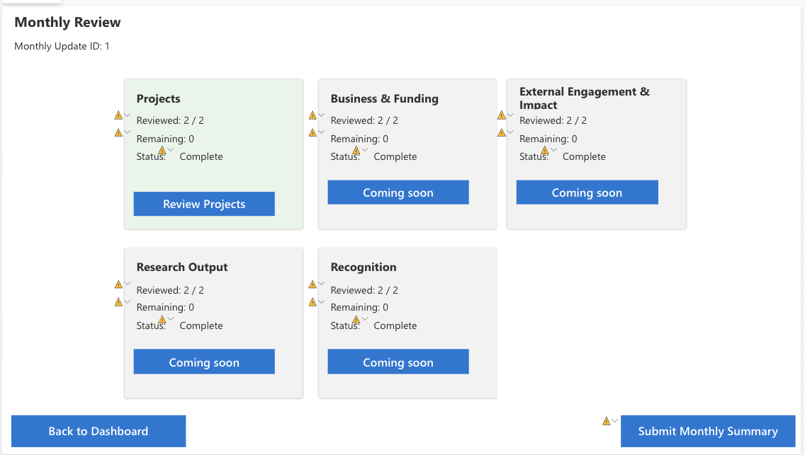
8) Draft of the monthly input view

